Slide 1

Stock Price Prediction
Present by
Jes Colbourne
Data Science & AI Program
Institute of Data

Slide 2
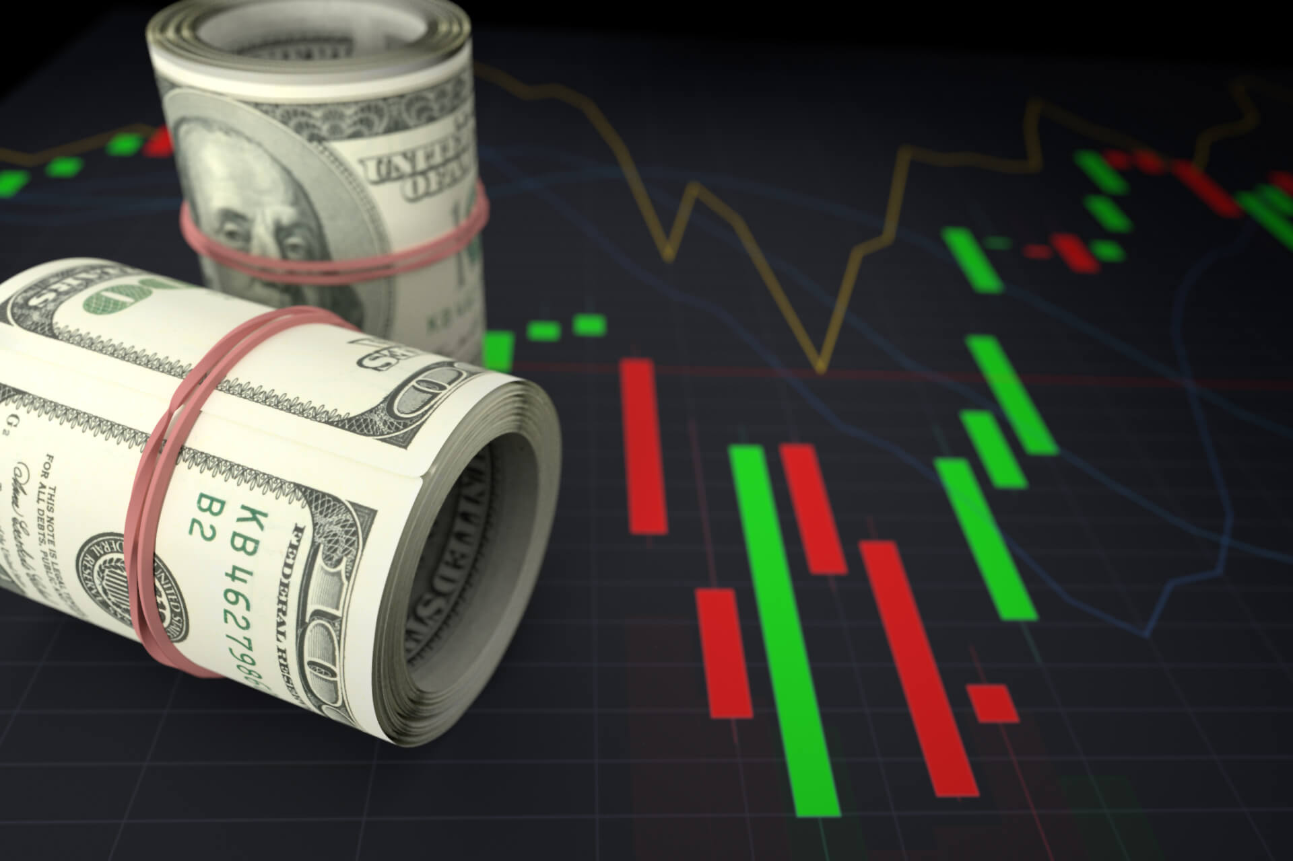
AGENDA
Biography
Business context
Dataset & Data pipeline
Data Science process
Deployment
Summary and recommendation

Slide 3

BIOGRAPHY
Jes Colbourne
Finance Officer
Education
Bachelor’s degree of Business Administration
Advanced Diploma of Naturopathy
Bachelor’s degree of Business (Accounting)
Data Science & AI Program
Professional experience
Over 5 years of health analysis and consultation in retail environment
Over 2 years of performance analysing and reporting of financial results

Slide 4

Business Context
Capitalization of listed Australian equity market is quite small comparing to other major overseas markets but our ratio to GDP ranks in the middle group with Japan and UK

Slide 5



ASX Australian Investor Study 2020
High value investors with median portfolio size of $1.2M
45% are women with median portfolio size of $90k
Next generation investor age 18-24 with median portfolio size of $50k

Slide 6
ASX Australian Investor Study 2020
Number of investors remained stable over the past 15 years
41% invest under $100k and 26% invest between $100k-$500k

Slide 7
ASX Australian Investor Study 2020
65% consider potential return on investment
86% invested within personal capacity

Slide 8
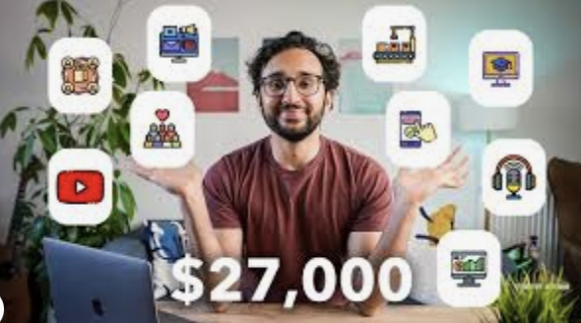

ASX Australian Investor Study 2020
41% prefer to receive investor education via YouTube

Slide 9
Problem statement
High value investors

Slide 10
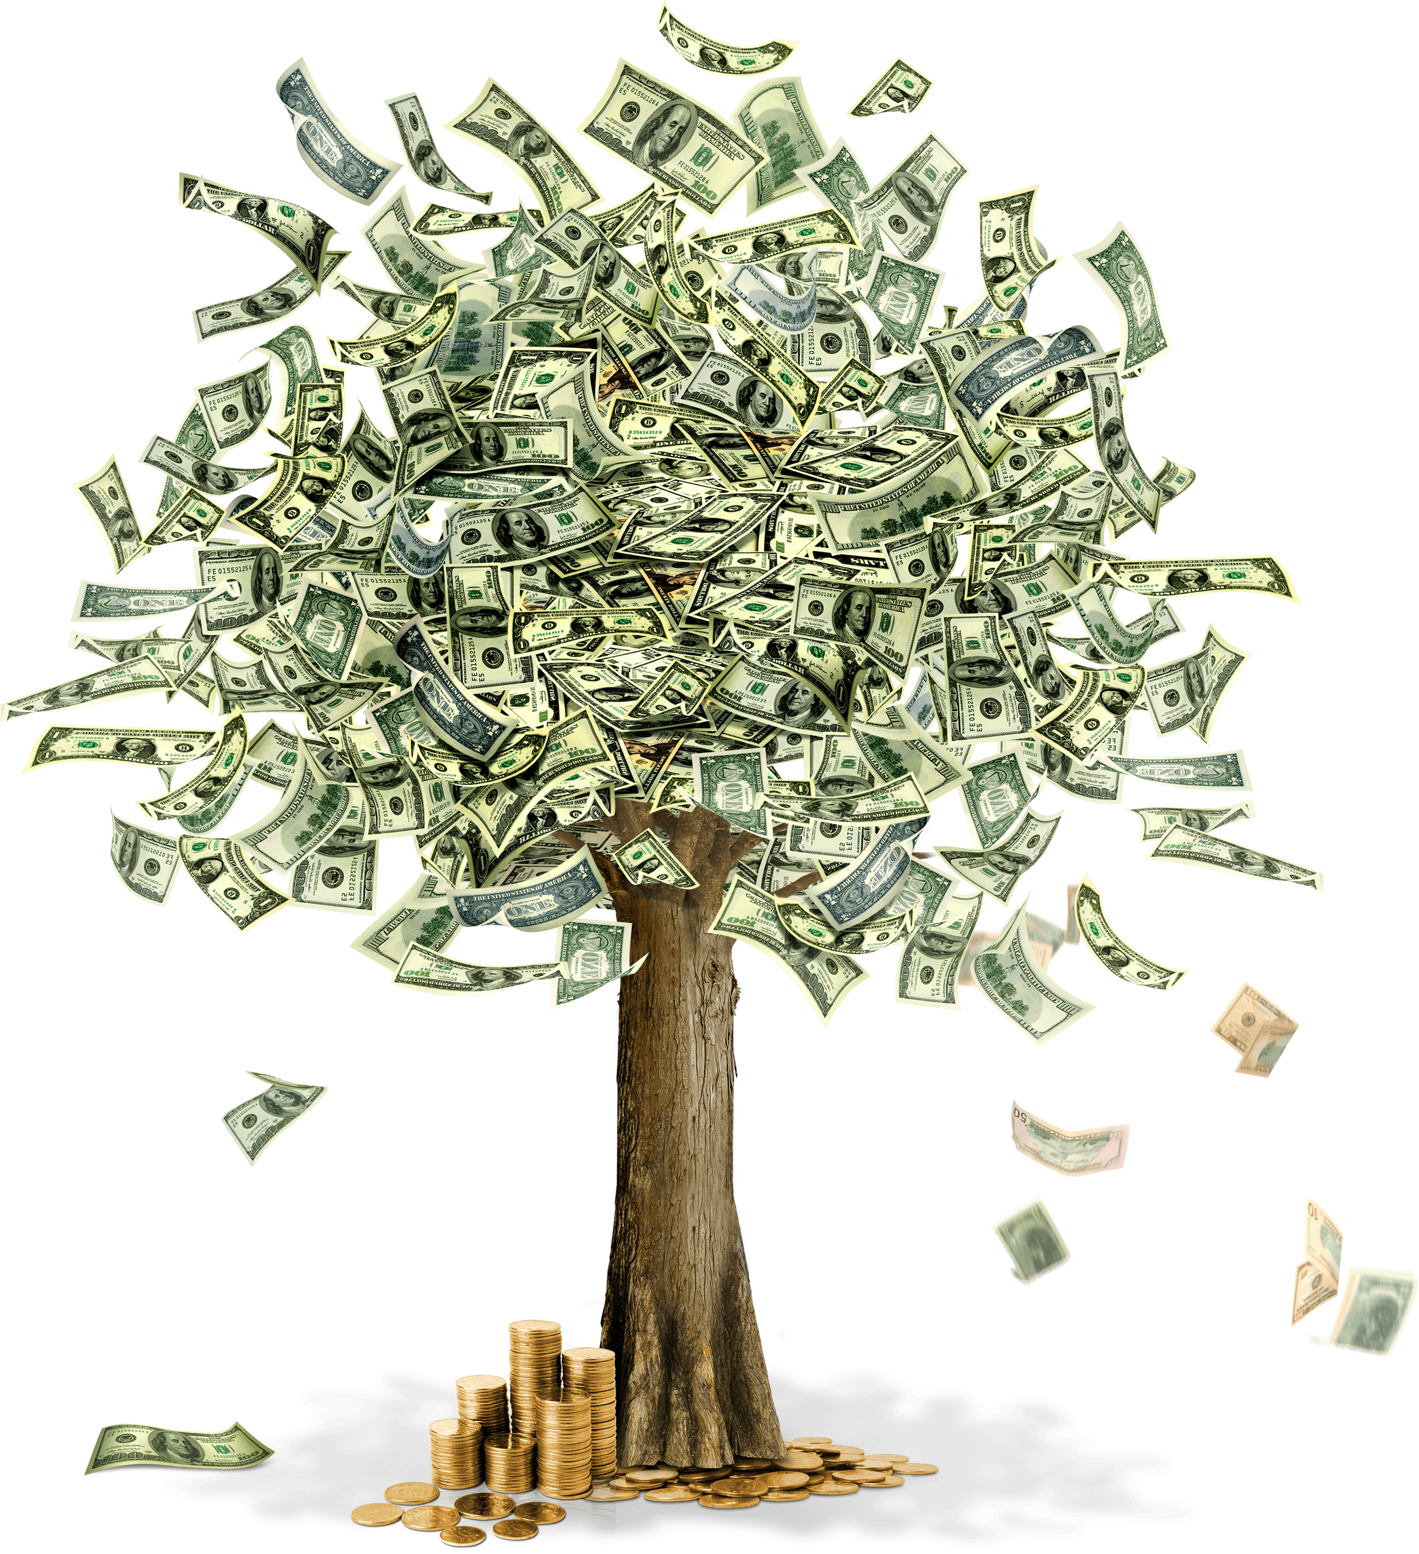
Business question
How to increase investment returns in stock market?

Slide 11
Dataset & Data pipeline

Slide 12
Dataset & Data pipeline
Data Acquisition
Data Pre-Processing
Data Integration
Model Selection
Training
Comparison
Validation
Deployment
Decision Making
Evaluation

Slide 13
Dataset & Data pipeline
Commonwealth Bank of Australia stock price historical data from October 1991 to September 2022

Slide 14
Dataset & Data pipeline

Slide 15
Dataset & Data pipeline
Major events
2003 – SARS
2010 – Swine flu
2015 – MERS
2019 – COVID-19

Slide 16
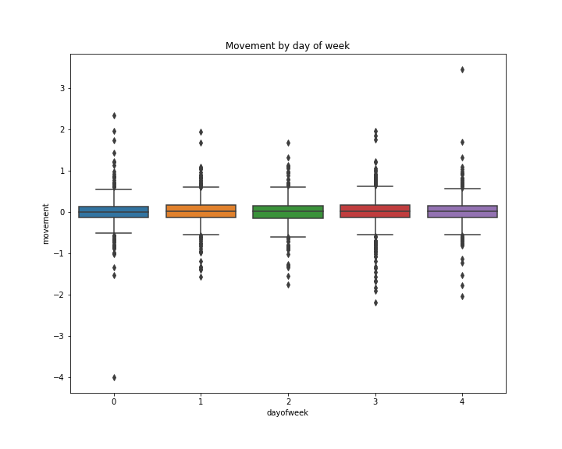
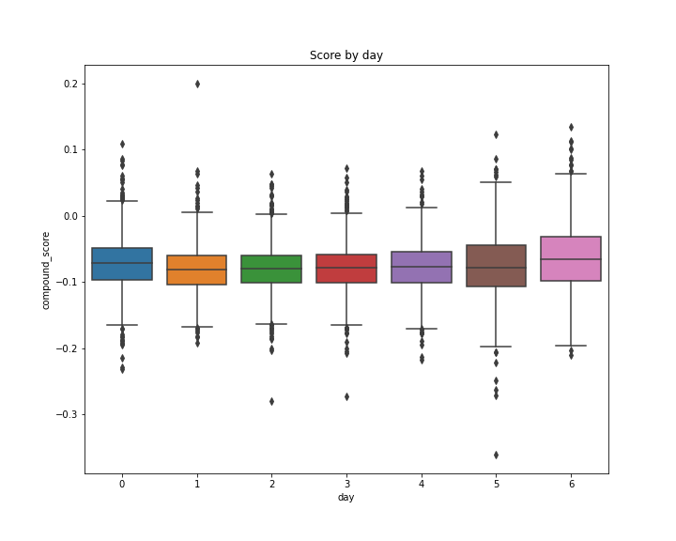
Data Science process: Data exploration

Slide 17
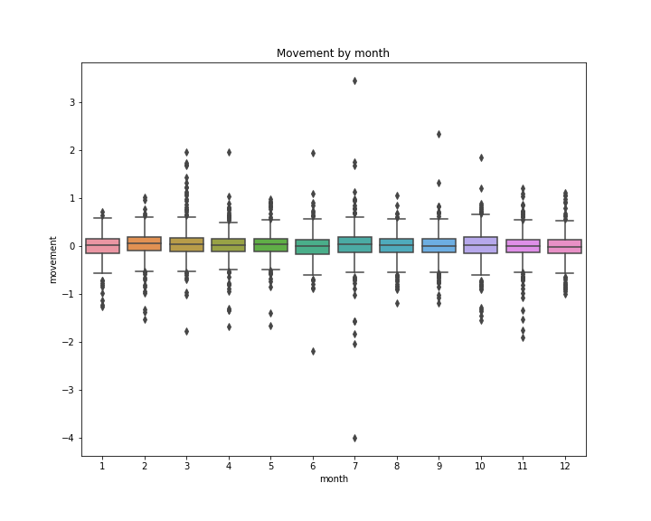
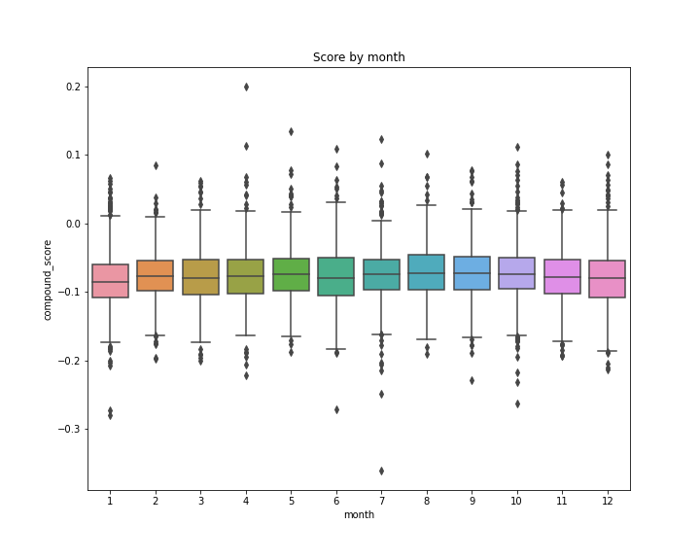
Data Science process: Data exploration

Slide 18
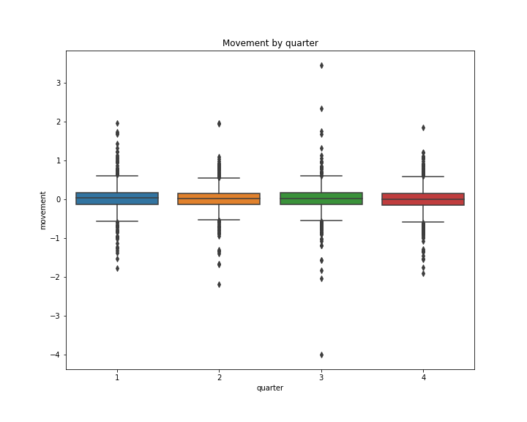
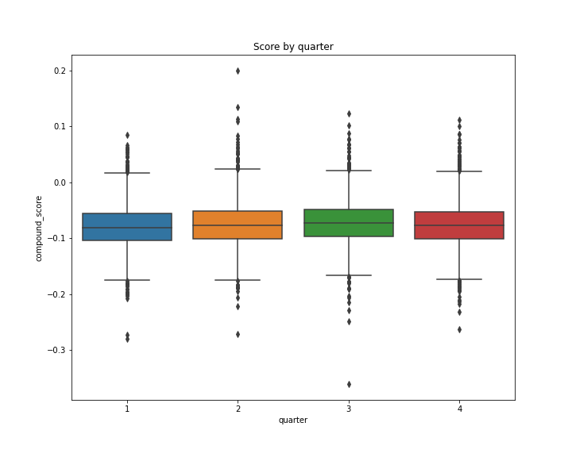
Data Science process: Data exploration

Slide 19
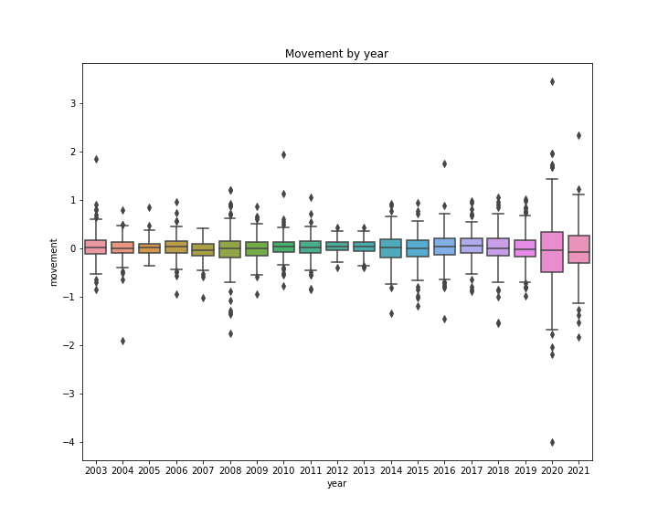
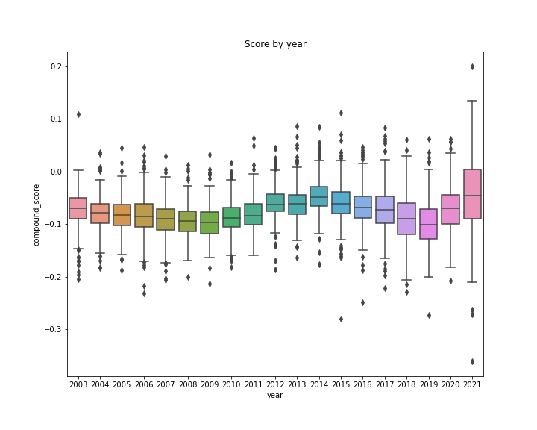
Data Science process: Data exploration

Slide 20
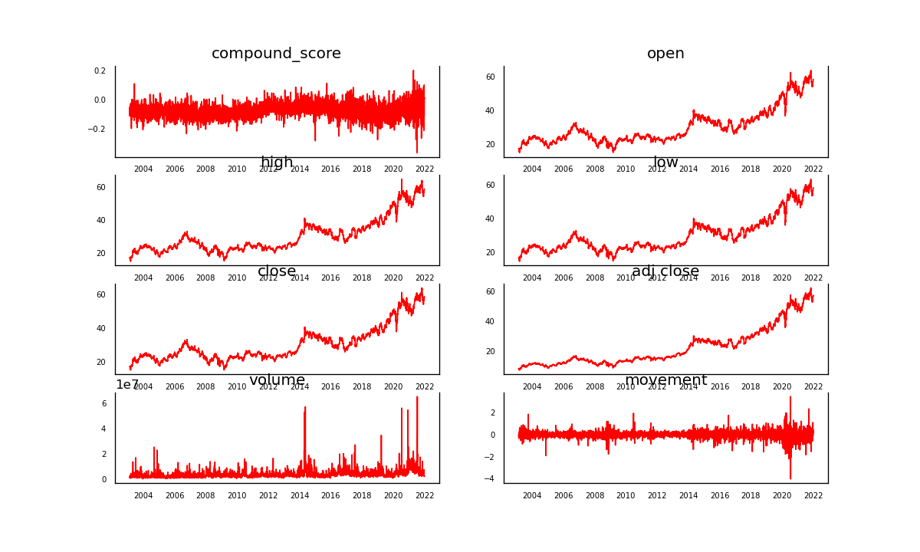
Data Science process: Feature correlation

Slide 21
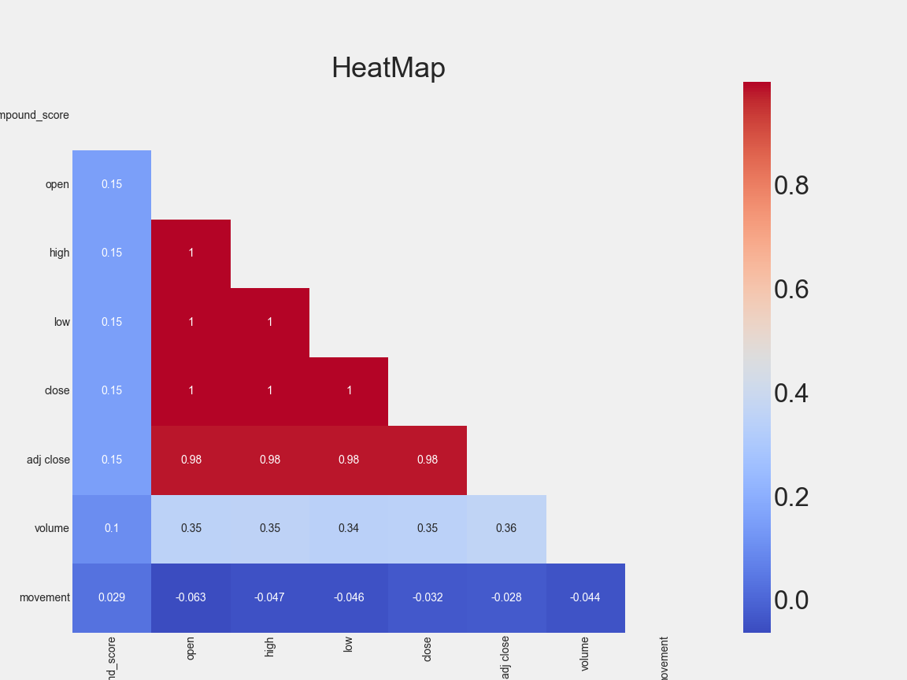
Data Science process: Feature correlation

Slide 22
Data Science process: Model results With Sentiment Score
Best model: ARIMA (2, 1, 2)
Test set
RMSE: 0.121
Test set
RMSE: 0.565

Slide 23
Data Science process: Model results Without Sentiment Score
Best model: ARIMA (3, 1, 1)
Test set
RMSE: 0.121
Test set
RMSE: 0.543

Slide 24
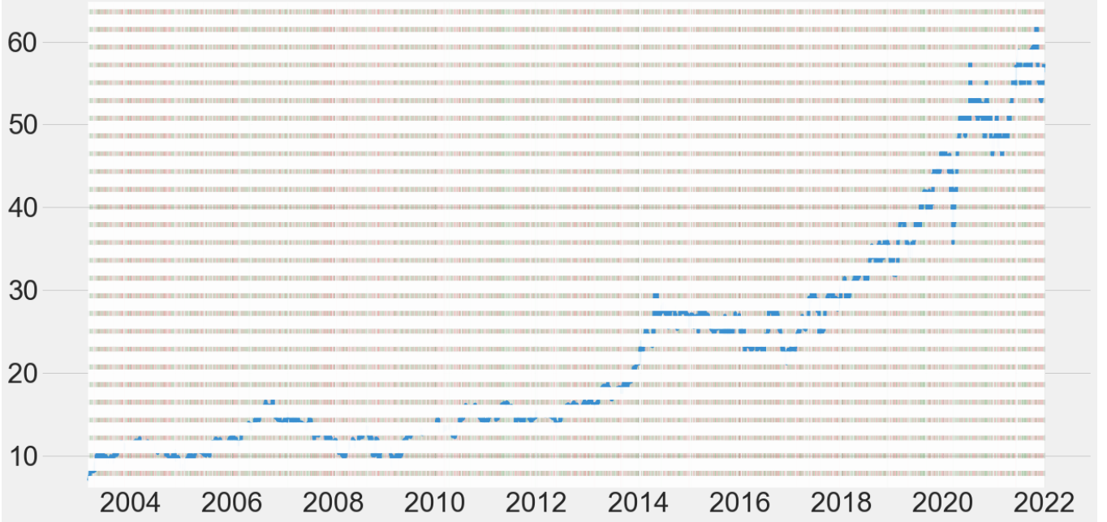
Deployment: Base model ARIMA (3, 1, 1)
Random buying: AZN stocks with $1,000 investment
Results:
Total value $3,079.59
Total return 207.96%

Slide 25
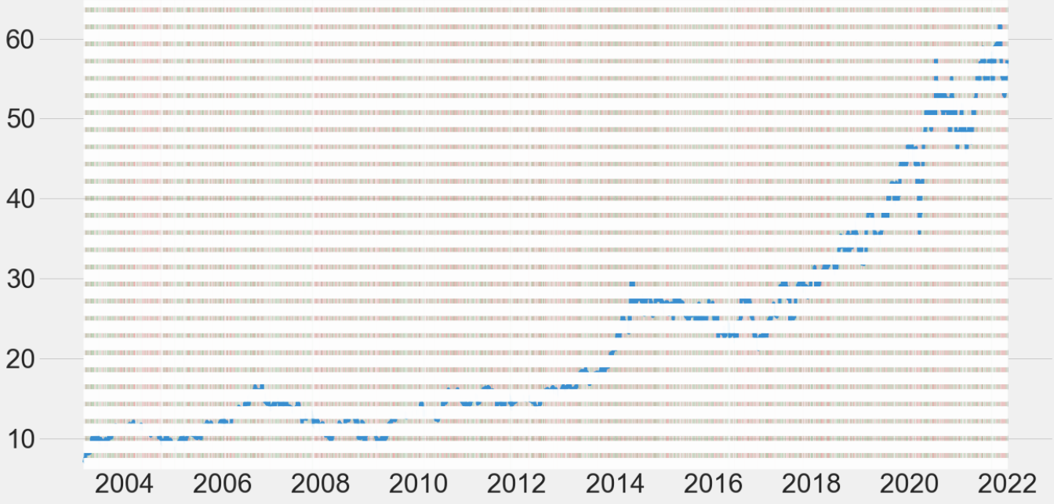
Deployment: Base model ARIMA (3, 1, 1)
Buy only if last return was positive: AZN stocks with $1,000 investment
Results:
Total value $636.88
Total return
-36.31%

Slide 26
Deployment: Qantas

Slide 27
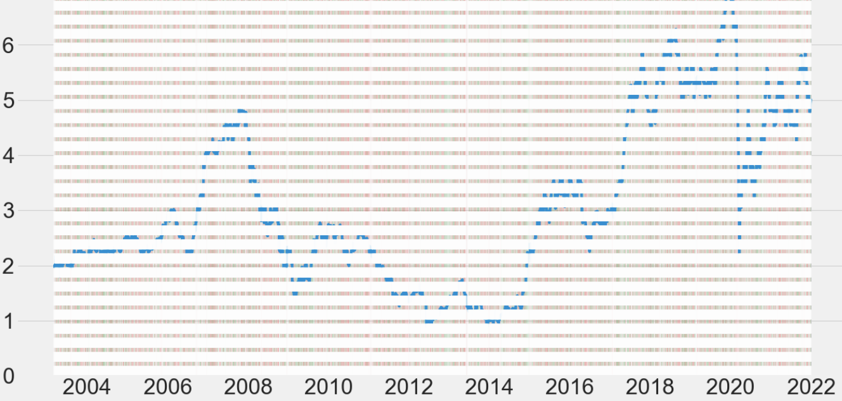
Deployment: Base model ARIMA (3, 1, 1)
Random buying: QAN stocks with $1,000 investment
Results:
Total value
$806.18
Total return
-19.38%

Slide 28
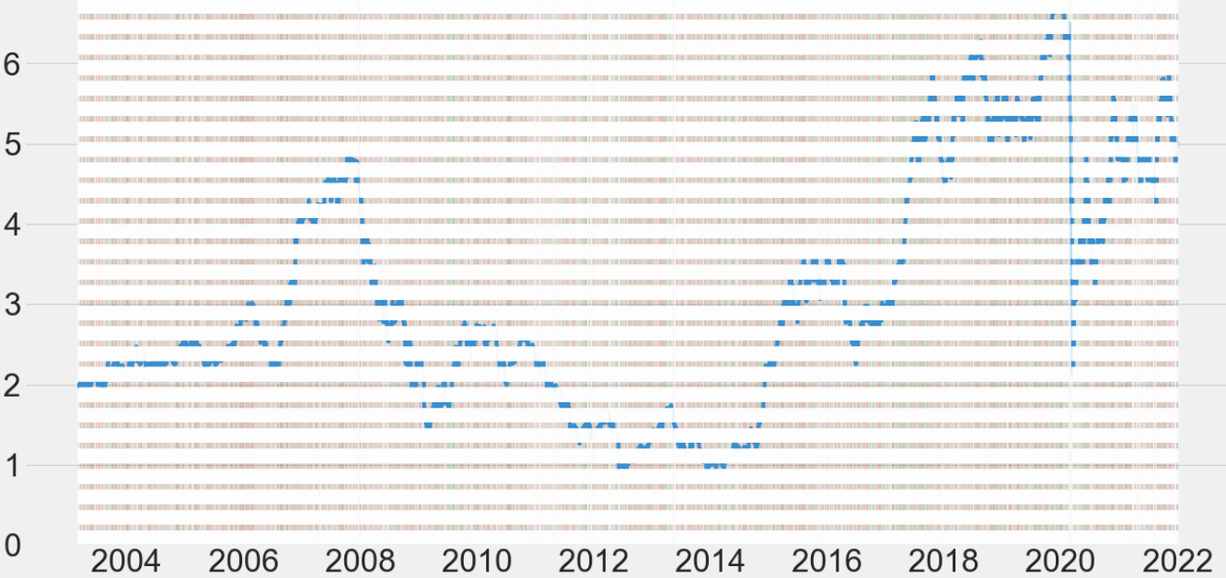
Deployment: Base model ARIMA (3, 1, 1)
Buy only if last return was positive: QAN stocks with $1,000 investment
Results:
Total value $1,348.64
Total return
34.86%

Slide 29
Summary
Best RMSE result was produced by model prediction without sentiment score
We may conclude that sentiment score possibly rather create white noise to the model than enhancing its results

Slide 30
Summary
Movement
Stock price movement prediction is possible when consider other factors that may have direct and indirect impact to the chosen stock based on its nature, industry and economic impacts around it.
Sentiment Score
Volume
Price

Slide 31
Next steps
Study technical analysis of market trend
Set up appropriate strategy of your investment plan
Test and set up rules-based strategy that is profitable
Optimise strategy outcome ie stop loss, buying target, risk-reward ratio, and time when the strategy work best
Risk management plan - managing the loss, keep you out of emotion when trade
Practice simulation/demo trading before investing real money
Discipline - don't gamble and stick to the strategy

Slide 32

Thank you ☺
-The End -

